Slide 1
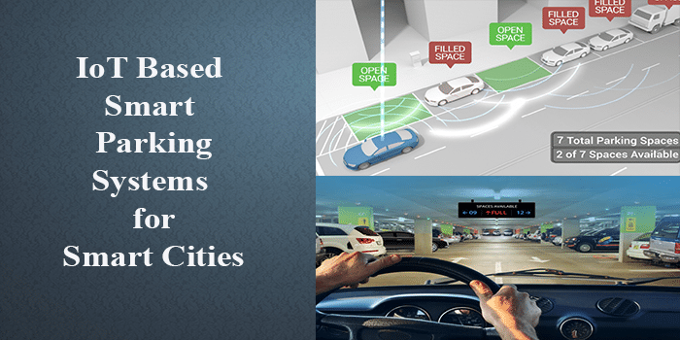

Slide 2
Project Definition
Smart parking project involves integrating IoT sensors into public transportation vehicles to monitor ridership , track locations and predict arrival times. The goal is to provide real-time transit information to the public through a public platform , enhancing the efficiency and quality of public transportation services. This project includes defining objectives , designing IoT sensor system , developing the real-time transit information platform and integrating them using IoT technology and Python.

Slide 3
Project Components and requirements:
Hardware:
IoT based smart parking system deployment requires various devices such as Sensors , Microcontrollers , Communication Modules , LED Displays.
Software:
Central Server , User Interface , Database , Algorithms.
Power Supply:
Reliable power sources for sensors and microcontrollers.
User Access Control:
Implement access control for users , administrators and maintenance personnel.

Slide 4
Project Steps:
Sensor Deployment:
Install sensors in each parking space to detect the presence of vehicles.Collect sensors to microcontrollers and power sources.
Data collection:
Set up microcontrollers to collect data from sensors.
Transmission:
Use communication modules to transmit data to the central server.
User Interface Development:
Create a web or mobile app for users to check parking availability.

Slide 5
Data Analysis and Prediction:
Use data analytics and machine learning to predict parking space availability based on historical data.
User Access Control:
Set up user authentication and authorization.
Real-time Displays:
Install LED displays at key locations to show real time parking availability.
Security Measures:
Implement security protocols to protect user data and the IoT infrastructure.
Maintenanace and Monitoring:
Regularly maintain and update the systems to ensure it runs smoothly.
Set up monitoring tool to detect and address hardware and software issues.
Data Privacy and Compliance:
Ensure compliance with data privacy regulations if applicable.

Slide 6
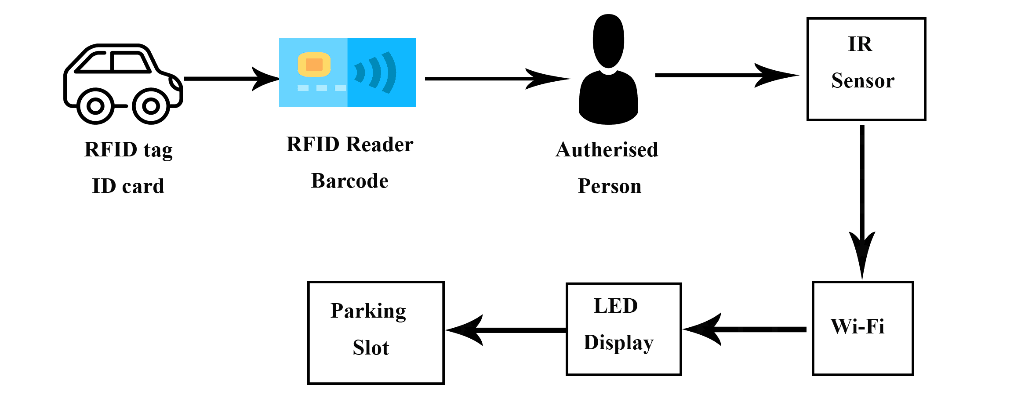
Flowchart:

